Slide 1

Security Onion PCAP Logging
Anthony Jamieson & Abdul Alqarni
UIW Intrusion Detection Systems
Dr. Gonzalo D. Parra

Slide 2
Executive Summary
We researched Security Onion as a low-cost solution to SIEM needs
Important for small businesses or businesses with a lower infosec budget
As a team we investigated the various features of Security Onion focusing on PCAP and network traffic analysis
We analyzed the various dashboards and investigation tools including:
Security Onion dashboard and alerts, Elastic Kibana, Grafana
We broke down our findings and experience with the included tools to measure Security Onion’s value as a SIEM

Slide 3
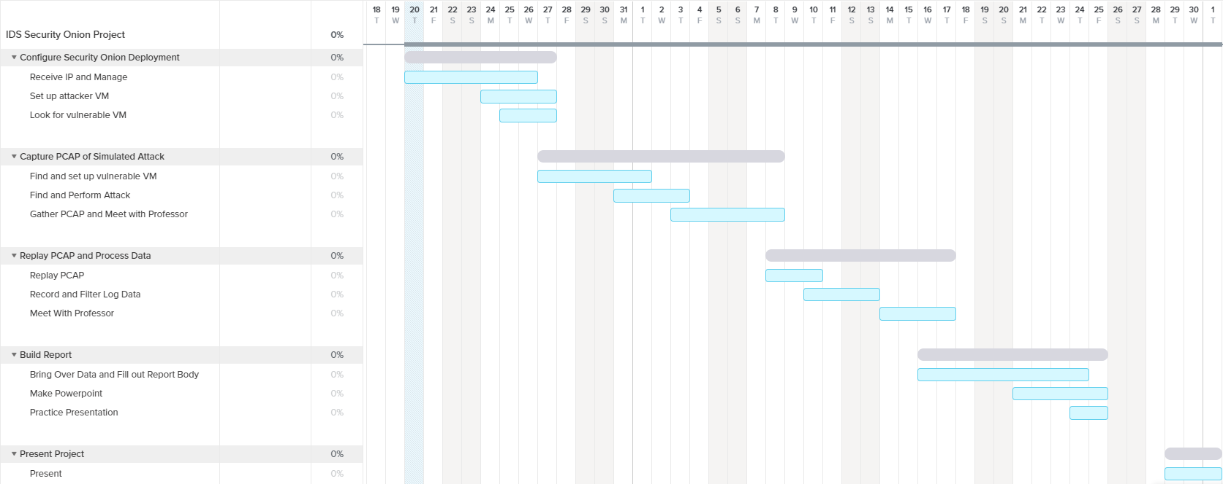
Gantt Chart

Slide 4
Configuring Security Onion Deployment
Milestone 1:

Slide 5
Deployment Configuration
We deployed Security Onion from the official .iso built on CentOS 7 in VMWare
Secondary node of Kali Linux to utilize Security Onion web interface
Two network adapters are needed for Security Onion deployment
We used:
NAT network for management interface
Bridged connection for monitor interface

Slide 6
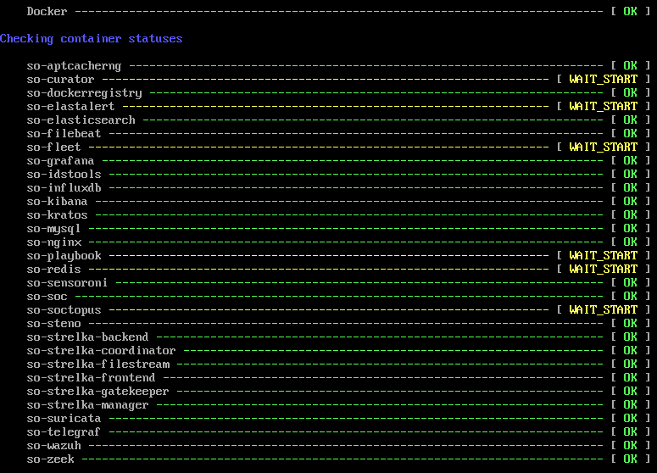
Deployment Issues
Executing “so-status” to verify machine integrity
Initial setup process is very confusing
Documentation is vague and expects a solid knowledge of network management
Connecting Security Onion to Kali node took multiple reinstalls
Security Onion is very resource intensive
Needs 200GB of storage, four CPU cores and 8GB of RAM by itself
Could not install on laptop, had to use home system
Security Onion kept running into a CPU lockup error
System would completely shut down at random intervals
Gave a time limit on what we could do at one time

Slide 7
Importing and Processing PCAP Files
Milestone 2:

Slide 8
SSH and Importing PCAP Files
To analyze PCAP Files, we decided to download suspicious PCAPs from Malware Traffic Analysis
Provided consistency and a variety of different threats to explore
“evtx” log files can also be imported in a similar way in place of or alongside PCAP files
Used Security Onion’s built-in PCAP importing command “so-import-pcap”
runs a PCAP through Zeek/Bro and Suricata to process through the Security Onion dashboard
To execute command, we SSH’d from our Kali node directly to our Security Onion system to make the process simpler

Slide 9
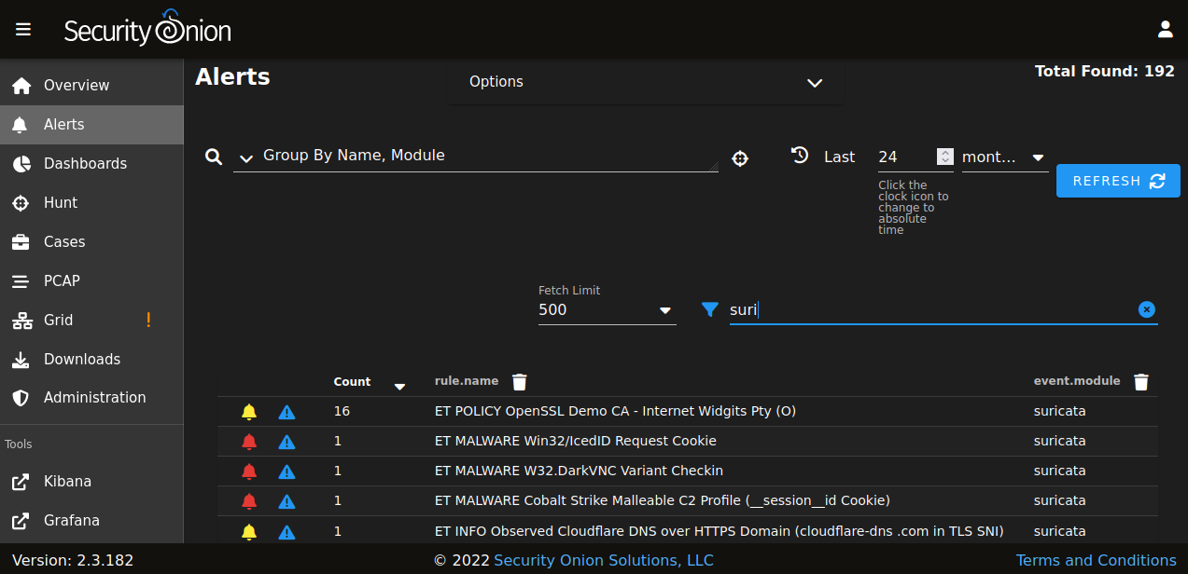
SSH and Importing PCAP Files (cont.)
Used “wget” to pull PCAPs directly from MTA and unzipped them on the Security Onion system
Processed the PCAP through “so-import-pcap” to push analysis to Security Onion dashboard and related tools
Verified PCAP integrity by navigating to specified timeframe and checking listed values in alerts and dashboard menu
Suricata alerts in Security Onion dashboard from “TA578 IcedID (BOKBOT) with DarkVNC and Cobalt Strike” PCAP

Slide 10
Evaluating and Sorting Log Files
Milestone 3:

Slide 11
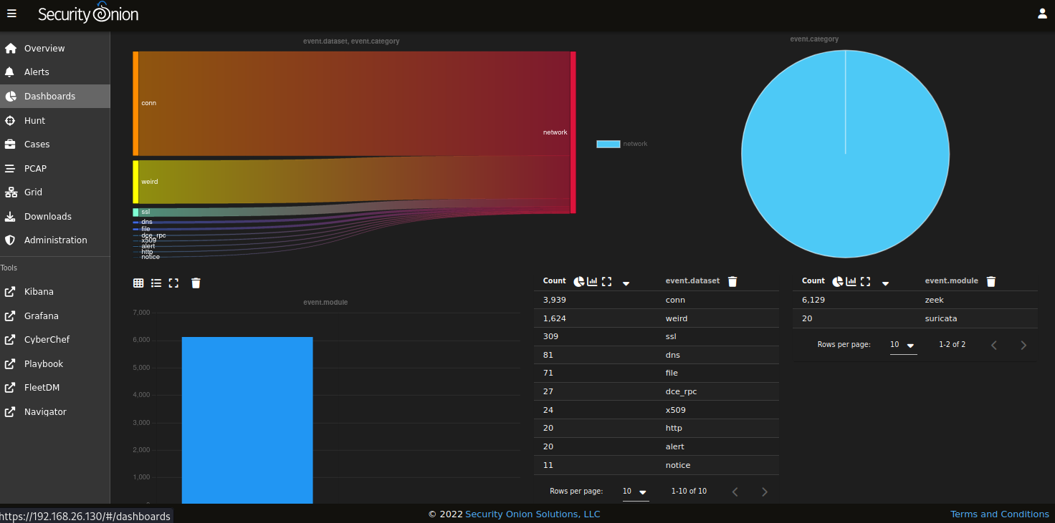
Analyzing Network Traffic
Inside Security Onion, imported PCAPs are automatically analyzed through both Suricata and Zeek/Bro to flag suspicious activity that breaches policy or includes know malware
Information is displayed in both SO Dashboard and Alerts
Dashboard shows the data is a more visual style, with graphs, charts and tables
Alerts lays out key rule conflicts in a list format with severity, IDS rule and module that detected the abnormal activity
Security Onion dashboard for “TA578 IcedID (BOKBOT) with DarkVNC and Cobalt Strike” PCAP

Slide 12
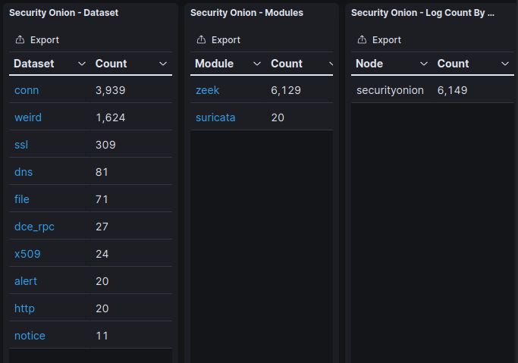
Analyzing Network Traffic (cont.)
Data can be “drilled down” through Security Onion to further break apart each alert in the system
Shows deeper data such as source and destination IPs, ports used, timestamps, location and more
Alerts can be flagged as evidence and pulled into “Cases” where groups of suspicious traffic can be aggregated and analyzed deeper
Provides focus to trace specific packets, users or other data across a network
Elastic functionality includes Kibana to give more options of displaying and filtering data in a more fleshed-out ecosystem
Elastic data tables from “TA578 IcedID (BOKBOT) with DarkVNC and Cobalt Strike”

Slide 13
Other Analysis Tools
Other tools that were included but not yet used were Grafana, CyberChef, Playbook, FleetDM and Navigator
Grafana works as another metrics dashboard, yet it is more focused on real-time data and system metrics for an entire deployment
As our scope was based around PCAPs, this dashboard was not as useful in the moment but provides plentiful real-world value
CyberChef is a collection of different cybersecurity tools, including hex editors, base10 converters, encryption tools and others
Playbook and FleetDM did not work in our environment, giving us a 404 when attempting to access them
Navigator pulls up an interactive copy of the MITRE ATT&CK cyber killchain

Slide 14
Findings
In our tests, Zeek seemed to consistently provide many more flags and alerts in our PCAP analysis
As an example, from “TA578 IcedID (BOKBOT) with DarkVNC and Cobalt Strike”:
Zeek alerts: 6,129
Suricata: 20
Over 300x more alerts through Zeek/Bro
Suricata seemed to focus on noting critical activity, such as detected malware, but Zeek provided a lot more context around the activity

Slide 15
Conclusion
Security Onion has an impressive amount of functionality for a free program
Good experience to tinker with for those wanting to expand CSEC skillset
Evaluating PCAPs is simplified to a few short commands
PCAPs are evaluated quickly and through multiple IDS tools at once (Zeek, Suricata, Strelka)
Data is laid out clearly for viewing, collecting and tracing
Lots of detail depending on what kind of PCAP is being imported
Security Onion offers a lot of value for a free tool, great for companies or users with a smaller budget or scope

Slide 16
Any questions?
Thank you for your time!

